Slide 1
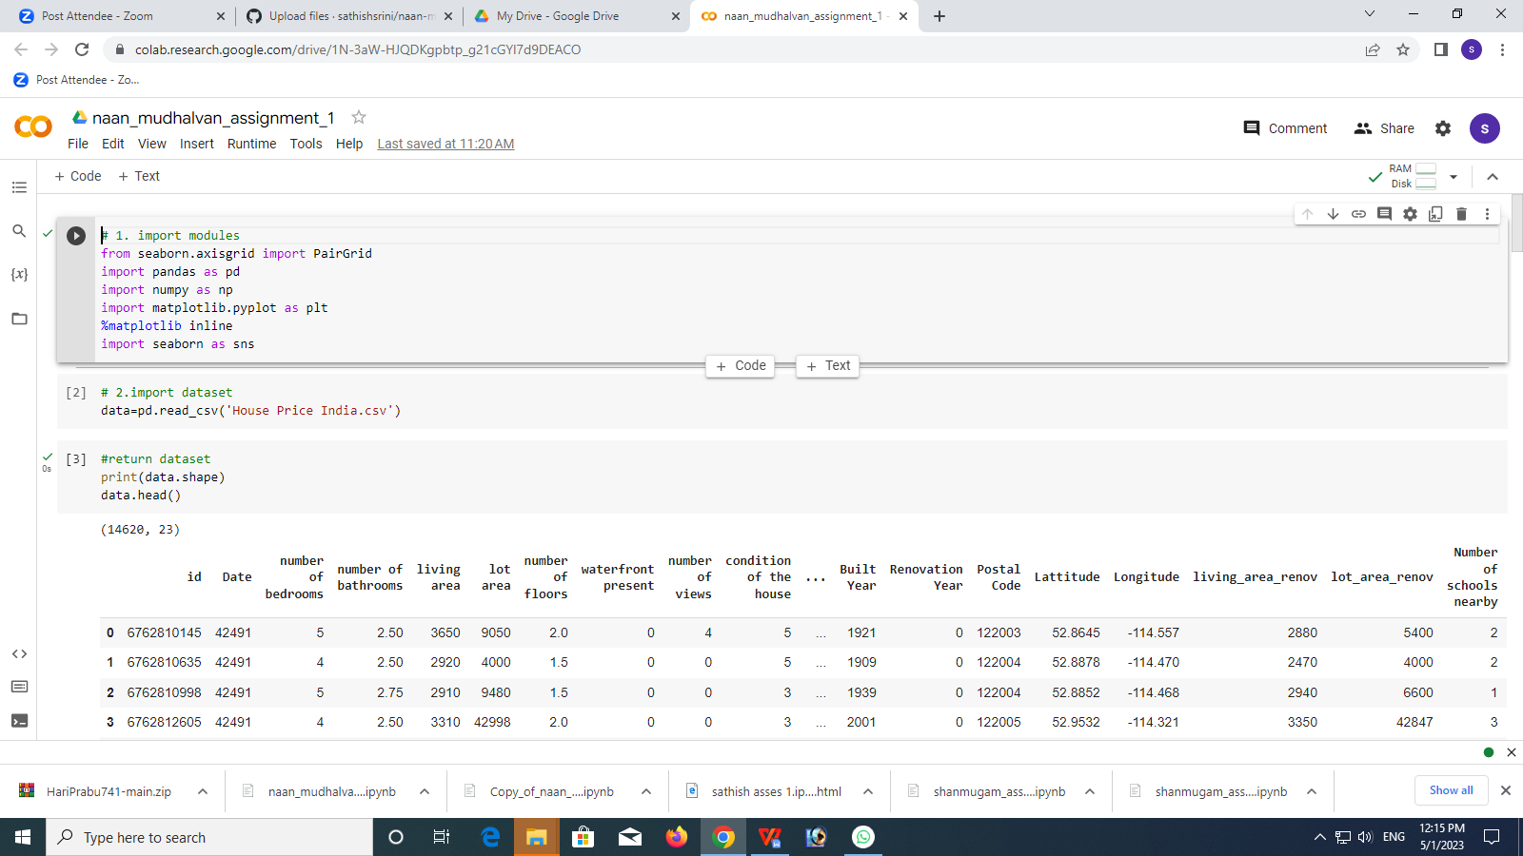
Naan Mudhalvan-Assignment 01
2.Uploading Dataset

Slide 2
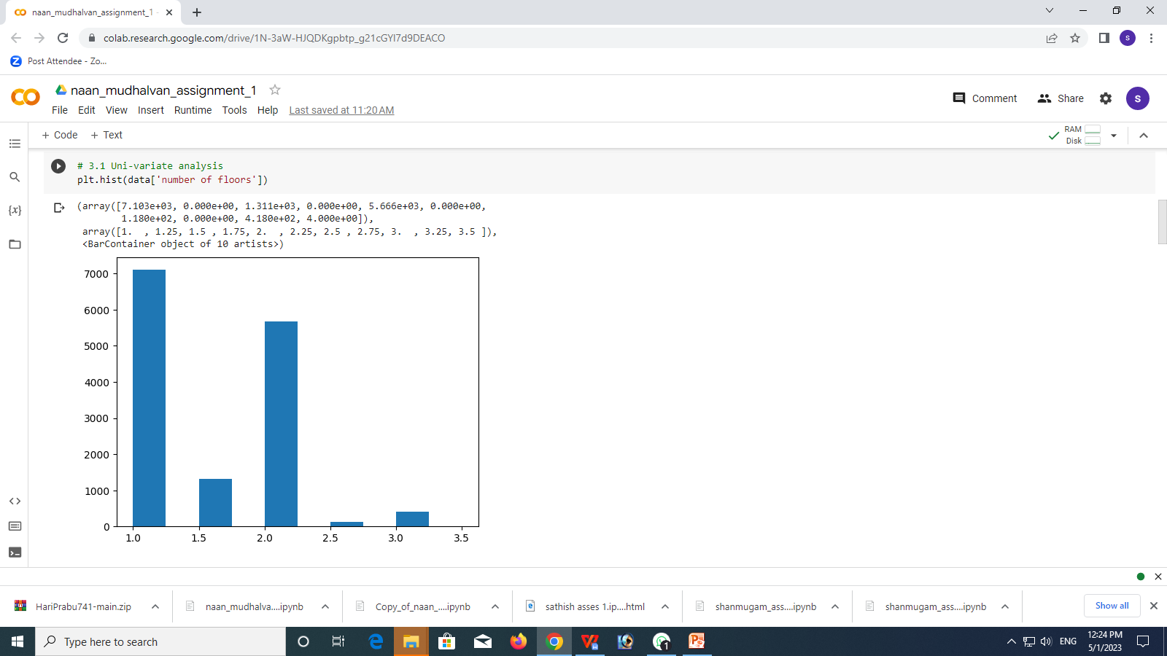
3.UNI-VARIATE ANALYSIS

Slide 3
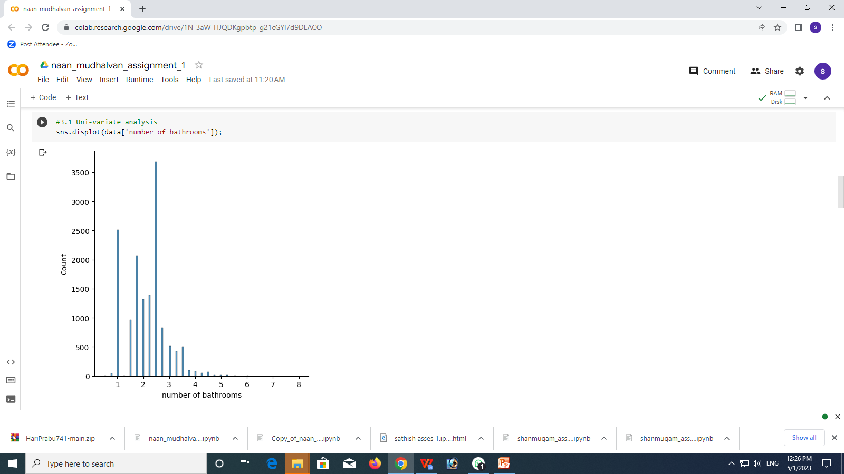

Slide 4
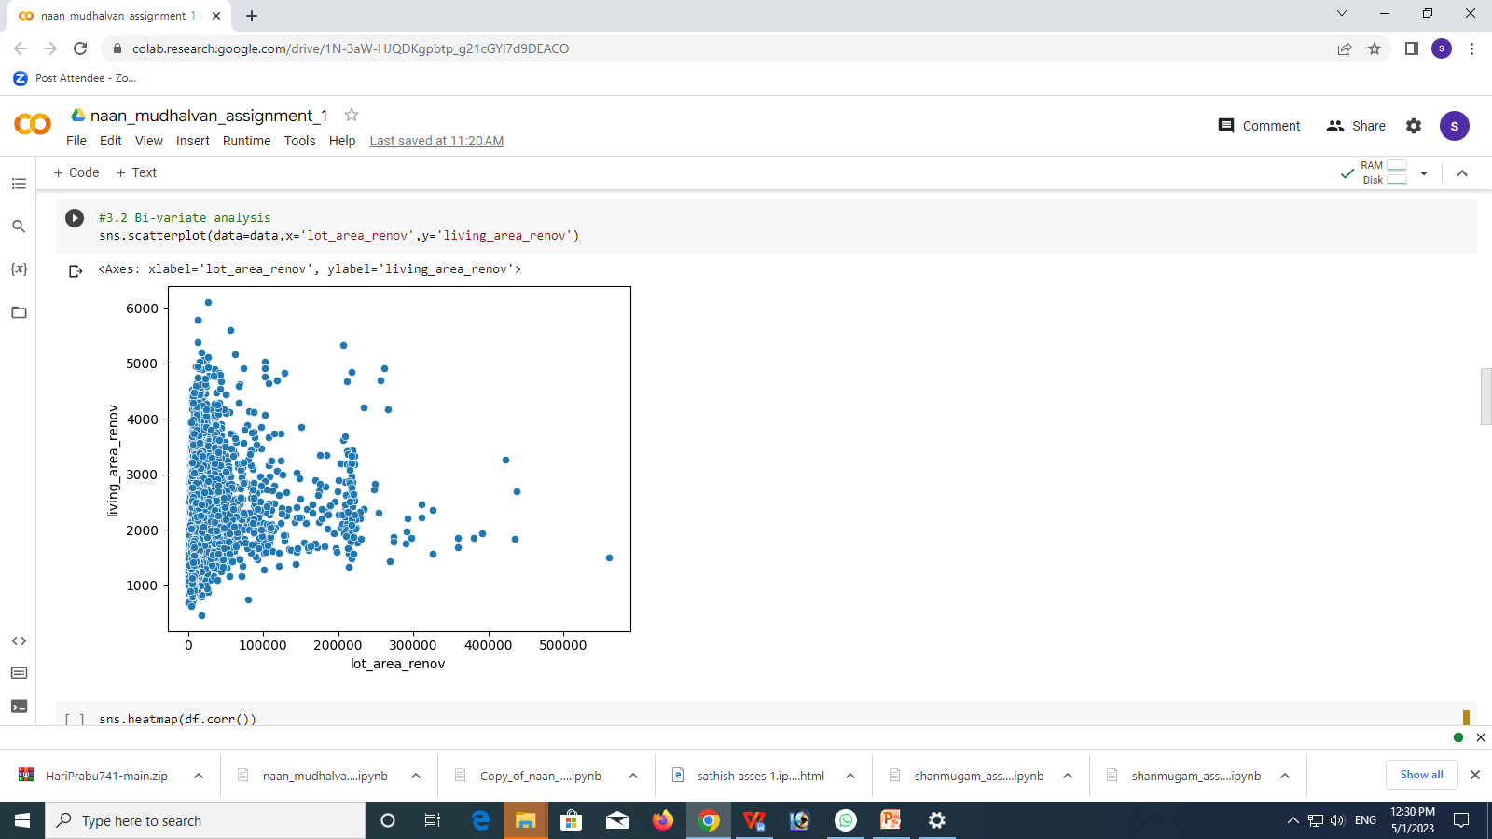
3. BI-VARIATE ANALYSIS

Slide 5
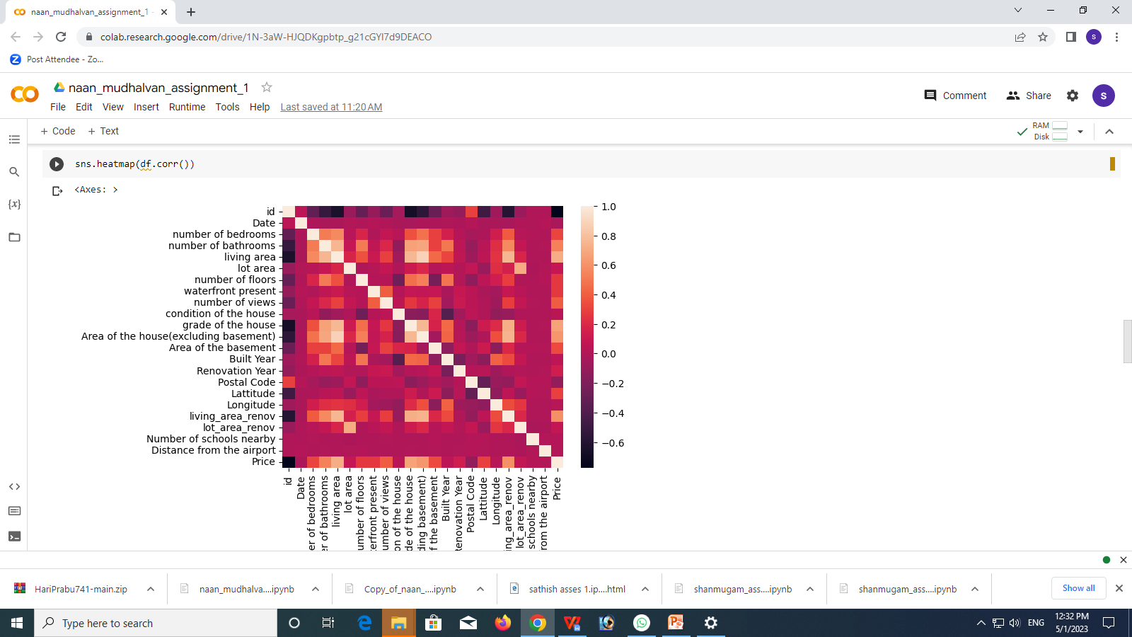

Slide 6
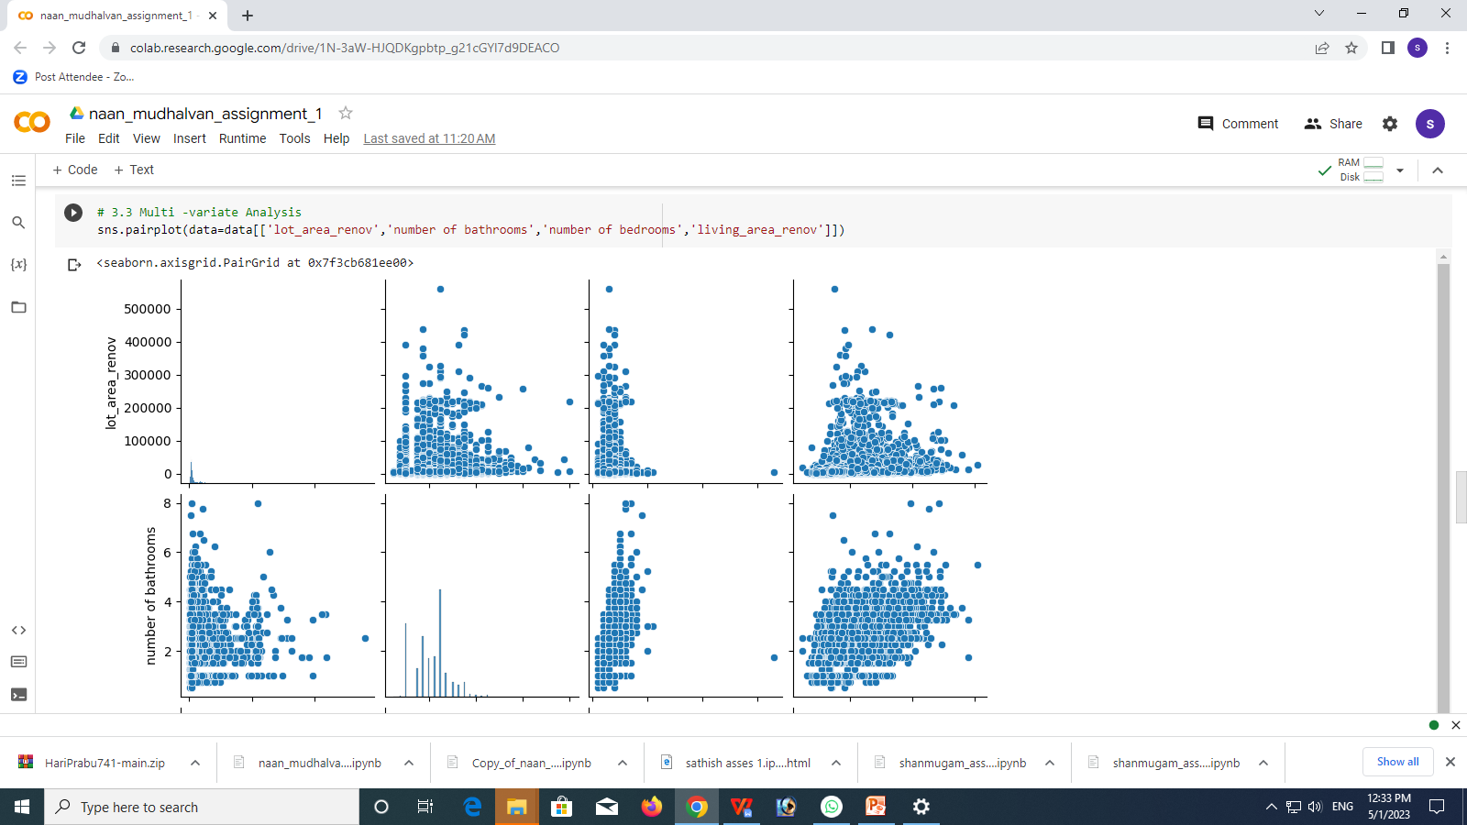
3.MULTI-VARIATE ANALYSIS

Slide 7
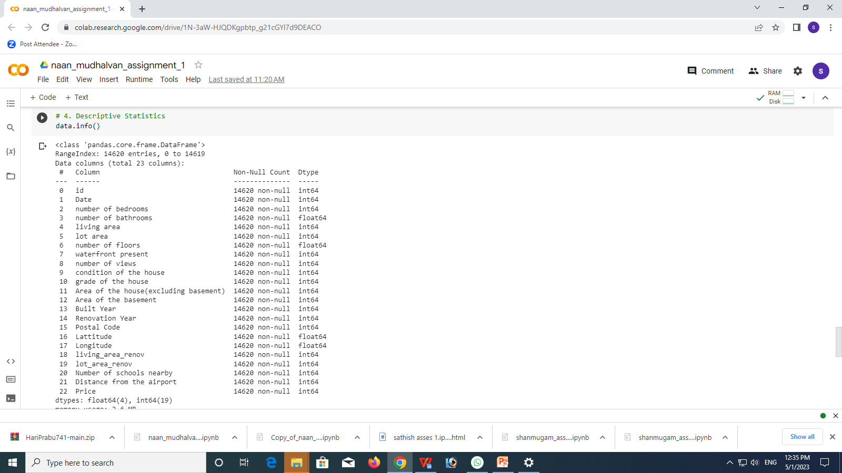
4.DESCRIPTIVE STATISTCS

Slide 8
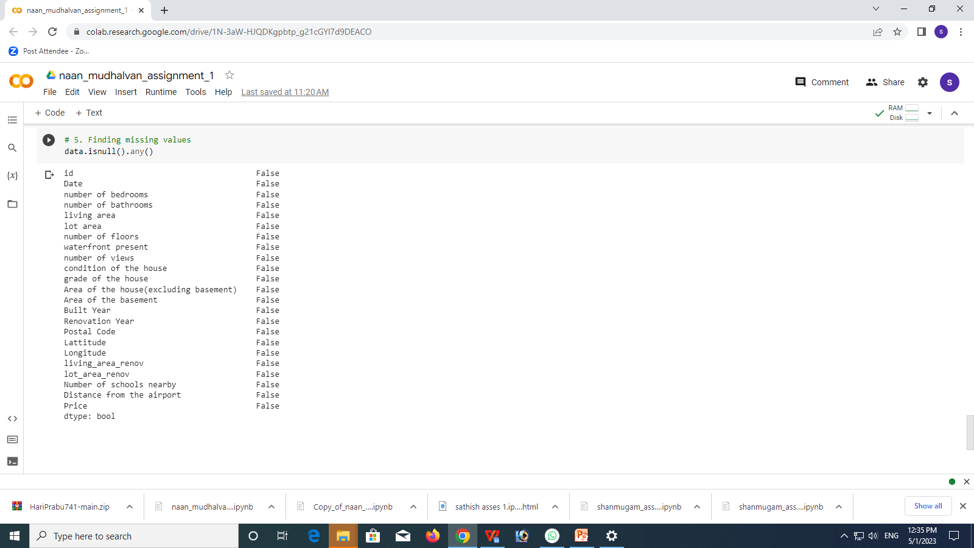
5.MISSING VALUES

